Slide 1
LIBRARY PROJECT
CS3354 Deliverable 2

Slide 2
Objective of project designed
Create a platform for college students that can allow them to buy, sell, or rent used textbooks, or books affordably with other students who need them.
This app will meet the demand for students looking for textbooks at lower prices, helping them save money while giving new purpose to their old books by selling them.

Slide 3
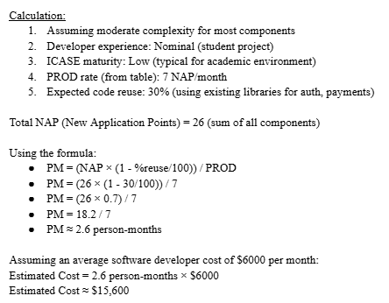
Cost estimation
The Application Composition Model
Estimated Cost ≈ $15,600

Slide 4
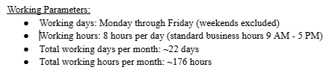
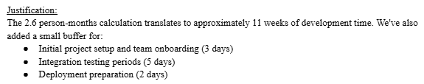
Project timeline
Start Date: January 15, 2025
End Date: March 31, 2025 (approximately 2.5 months)

Slide 5
Functional requirements (Jerin)
User Registration and Authentication
Textbook Listing Management
Textbook Search and Filter
Transaction and Payment Processing
Communication and Reviews
Book Return and Dispute Handling

Slide 6
Non-Functional Requirements Overview
Objective: Ensure a robust, secure, and user-friendly system.
Key Themes: Reliability, Performance, Usability, Development Practices and Scalability
Notes:
This presentation will cover the critical non-functional requirements that guide the development and operational goals of our system.

Slide 7
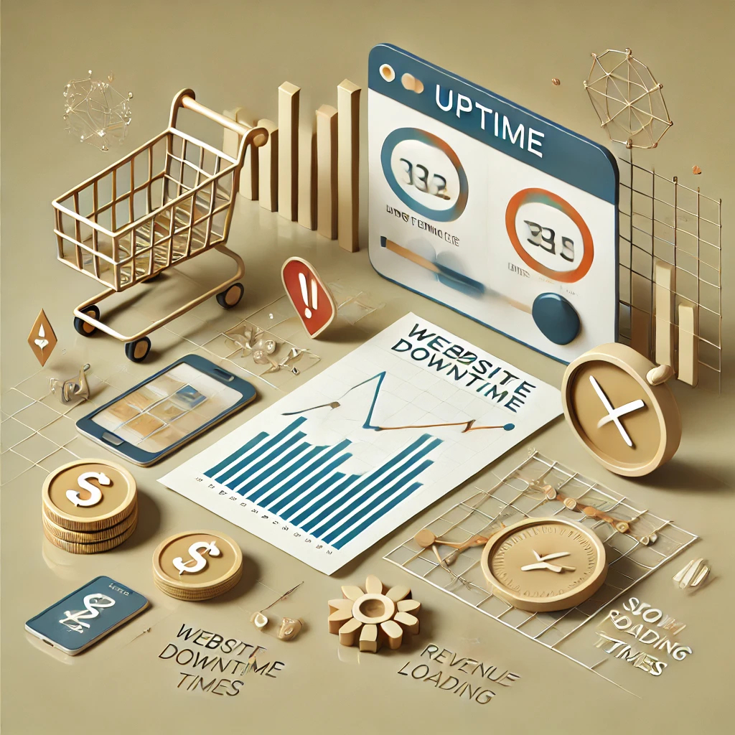


Reliability
Dependability: High availability, backup & recovery
Minimal Downtime: Ensuring uptime even during maintenance
Notes:
Reliability is a top priority. The system must be dependable, with high availability and reliable backup systems to prevent data loss.

Slide 8


Security (Product)
Authentication: Secure user login, password encryption
Payment Security: Safe gateways for transactions
Notes:
Our security measures include secure authentication, encrypted logins, and protected payment systems, ensuring that user data remains private and secure.

Slide 9
Security (Legislative)
Compliance: Data protection regulations
User Protection: Prevent unauthorized access
Notes:
Our system complies with data protection regulations to safeguard user information and prevent unauthorized access to accounts.

Slide 10


Regulatory Compliance
Adherence to laws and regulations
Transparent data usage policies
Notes:
Compliance with e-commerce laws and data privacy regulations is vital to maintain transparency and user trust in our application.

Slide 11
Ethics & Environmental Responsibility
User Reporting: Fraud and scams
Environmental Focus: Sustainable practices
Reduce Paper Use: Digital documentation
Optimize Energy: Energy-efficient systems
Notes:
We prioritize ethical and environmental responsibility, allowing users to report scams and reducing our environmental footprint through sustainable practices and energy efficiency.

Slide 12
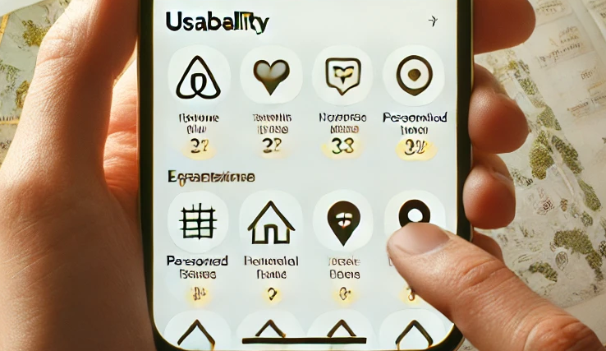
Usability
Easy Navigation & Interface
Responsive on Desktop & Mobile
Quick Account Access
Features to Manage Books & Rentals
Notes:
Usability is key, with a focus on intuitive navigation, efficient account management, and a responsive design across devices to ensure a seamless experience for users.

Slide 13



Performance & Space Optimization
Quick Response: Fast page loads
Handle High Traffic
Efficient Data Storage: Database management
Maintain Performance Metrics
Notes:
Our system maintains optimal performance under high traffic, with quick response times and efficient space management for database storage.

Slide 14
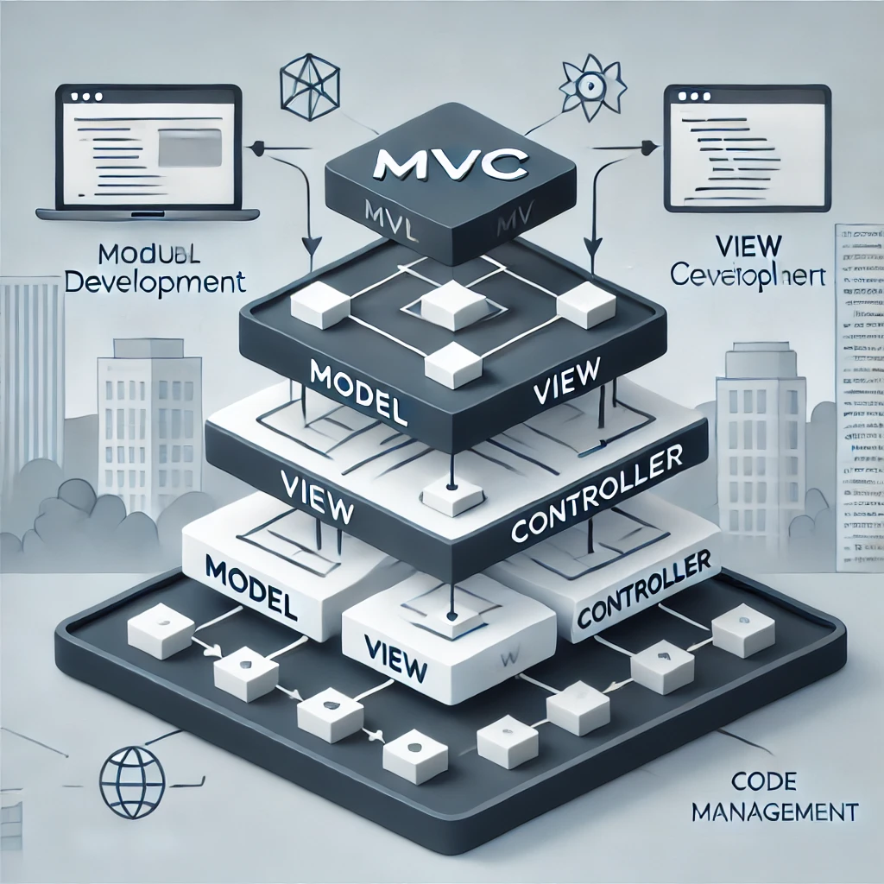
Development Practices & Scalability
MVC Architecture: Modularity
Easy Third-Party Integration
Scalable for Future Features
Notes:
Using MVC architecture and integration options ensures a modular and scalable system that can adapt to future needs and easily integrate with third-party services.

Slide 15
Accounting & Transparency
Detailed Transaction Histories
Clear Itemized Receipts
Accurate Calculations of Fees, Discounts
Notes:
To promote transparency, users can view detailed transaction histories and receive clear, itemized receipts, ensuring accuracy in fees and discounts.

Slide 16


Conclusion
Commitment to Quality & Improvement
Questions?
Notes:
These non-functional requirements lay a solid foundation for building a system that is dependable, secure, and user-friendly.

Slide 17

Citations
Reliability and Performance
Impact of Uptime on User Retention and Revenue Example: Amazon has estimated that just a one-second slowdown in load times could cost it $1.6 billion in sales each year. This illustrates the immense impact that downtime and slow performance can have on revenue. By ensuring reliability and high uptime, companies not only retain their current customers but also prevent significant revenue loss, particularly in e-commerce and high-traffic services.
Source: Hamilton, J. (2018). "Internet Scale in the Cloud: Scaling to 10 Billion Requests Per Day and Beyond," Communications of the ACM, vol. 61, no. 8, pp. 92-101. Available via ACM Digital Library.
Performance - According to Netflix, reducing buffering by just 10% resulted in a 20% increase in user watch time. This demonstrates how performance improvements not only enhance user satisfaction but also directly impact engagement and retention, giving Netflix a competitive edge in the streaming industry.
Source: A. Cockcroft, "Performance and Reliability in Netflix Streaming: A Case Study," IEEE Internet Computing, vol. 20, no. 3, pp. 73-77, 2018.
Airbnb - Usability Enhancements on Mobile Increased Engagement Example: Airbnb improved its app's usability by optimizing maps for mobile use, providing personalized filters, and offering quick booking options. These changes not only increased app engagement but also directly influenced revenue, as users were more likely to complete bookings on a mobile-friendly platform. This case highlights how usability improvements can lead directly to business benefits. 60 percent of its bookings are made on a mobile device.
Source: Morgan, B. (2018). "How Airbnb's Focus on Usability Enhances Customer Experience," Forbes. Retrieved from Forbes.
MVC for Modular Development - GitHub Case Study Example: GitHub uses MVC architecture to keep its platform modular and scalable, making it easier for developers to independently manage different parts of the application. This architecture allows GitHub to handle millions of users' requests daily while keeping each component (models, views, and controllers) manageable. By using MVC, GitHub can also integrate new features without disrupting existing functionality, which is essential for a large, active platform.
Source: Kalliamvakou, E., et al. (2014). "The Promises and Perils of Mining GitHub," ACM Conference on Mining Software Repositories (MSR). Available via ACM Digital Library.

Slide 18
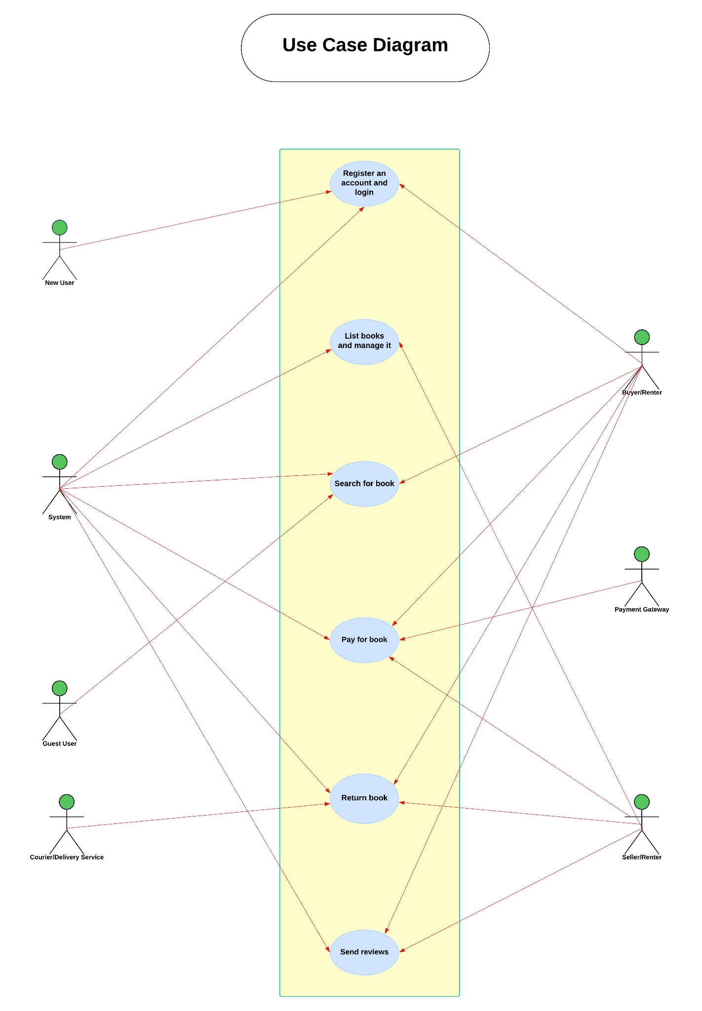
Use Case Diagram

Slide 19
Sequence diagram

Slide 20
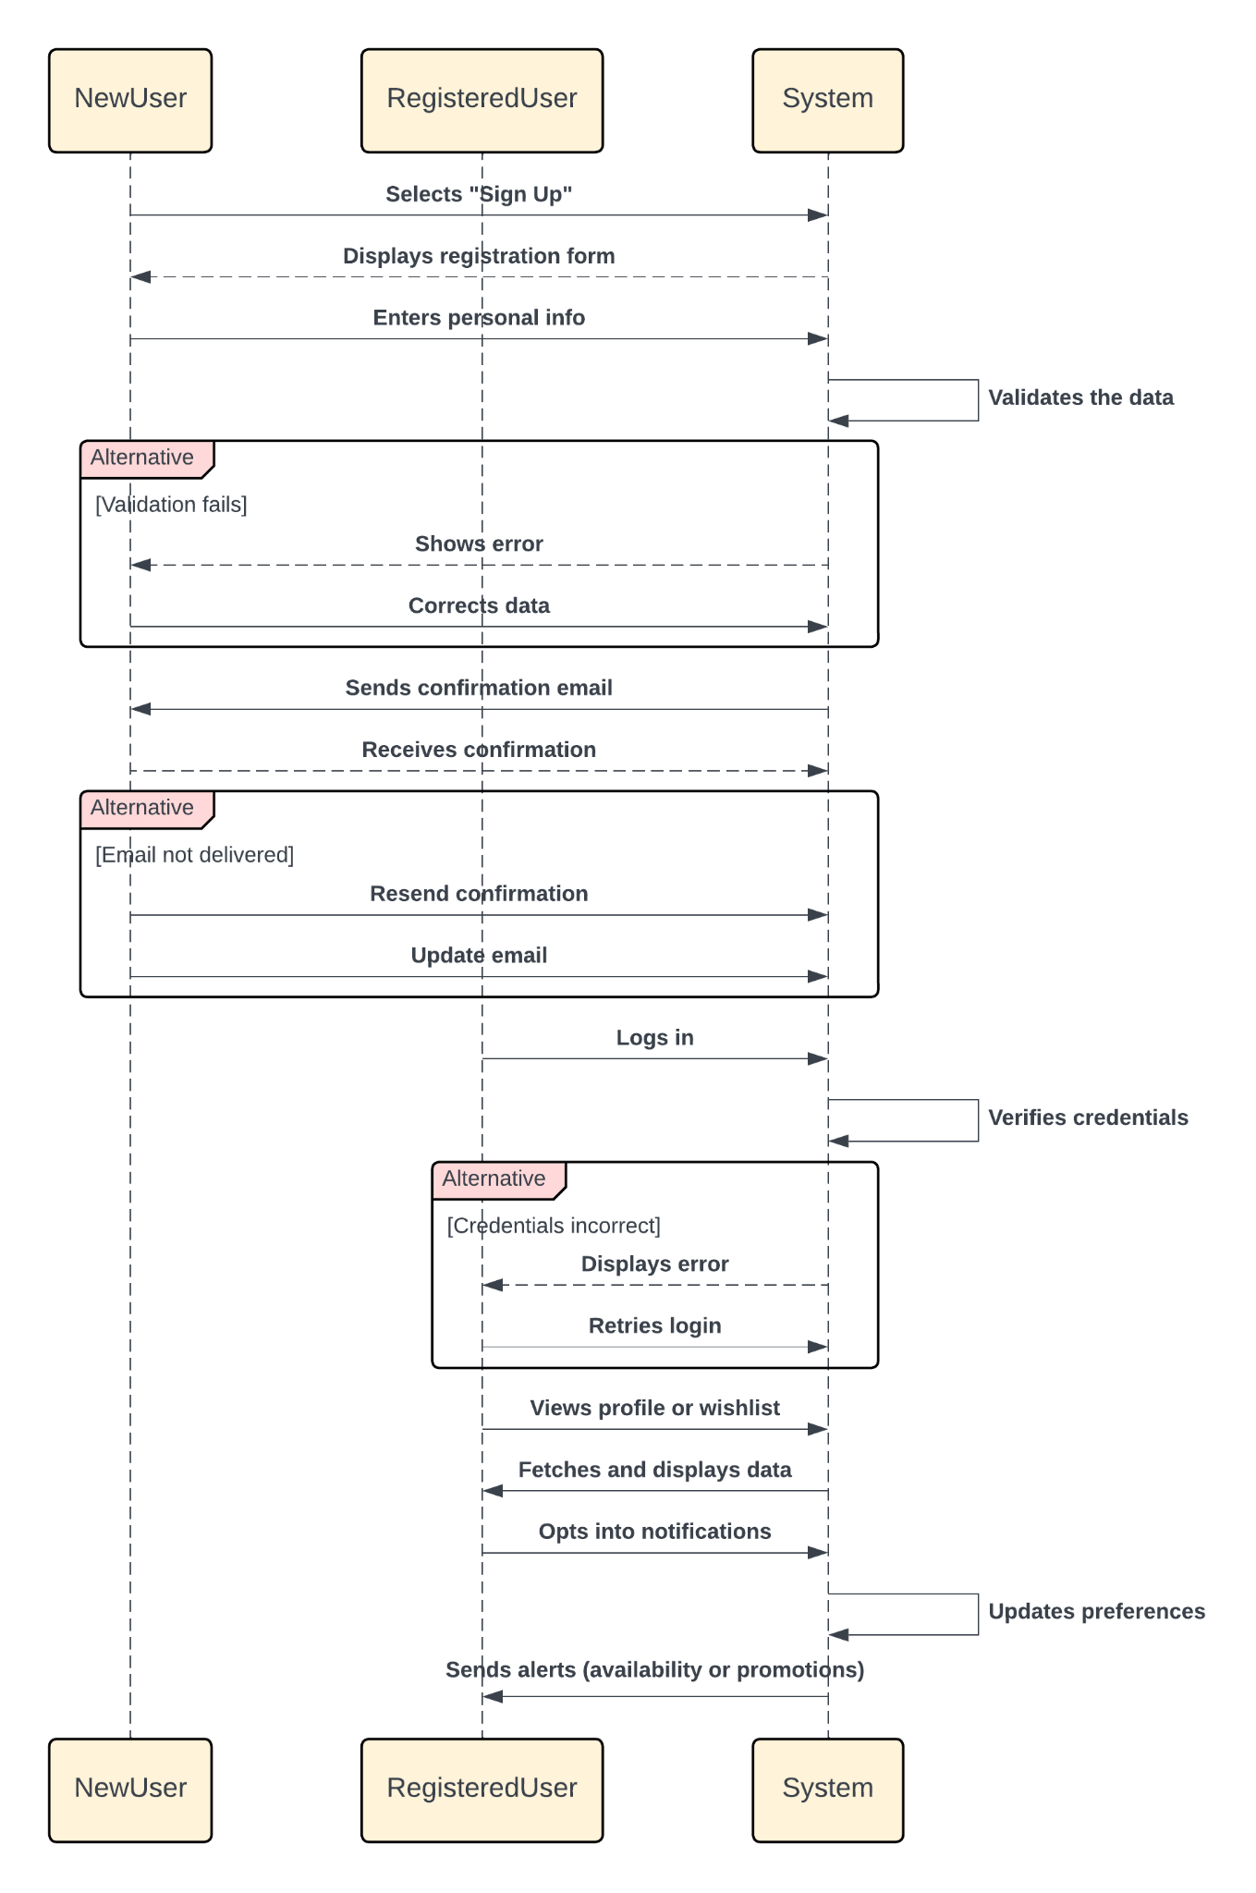
1) Register an account and login
A new user registers and receive account confirmation, and registered users log in to access their profile, history, and Wishlist.

Slide 21
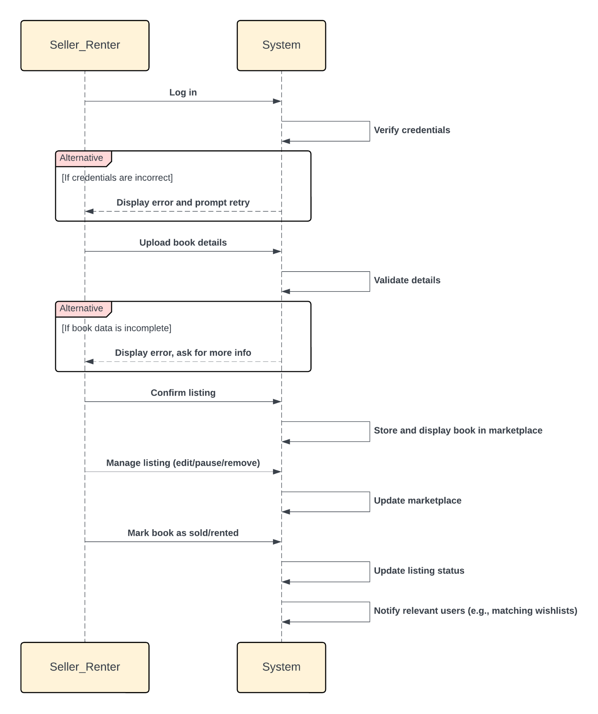
2) List books and manage it
The seller or renter logs in, uploads and confirms book details, and the system validates and displays the listing.

Slide 22
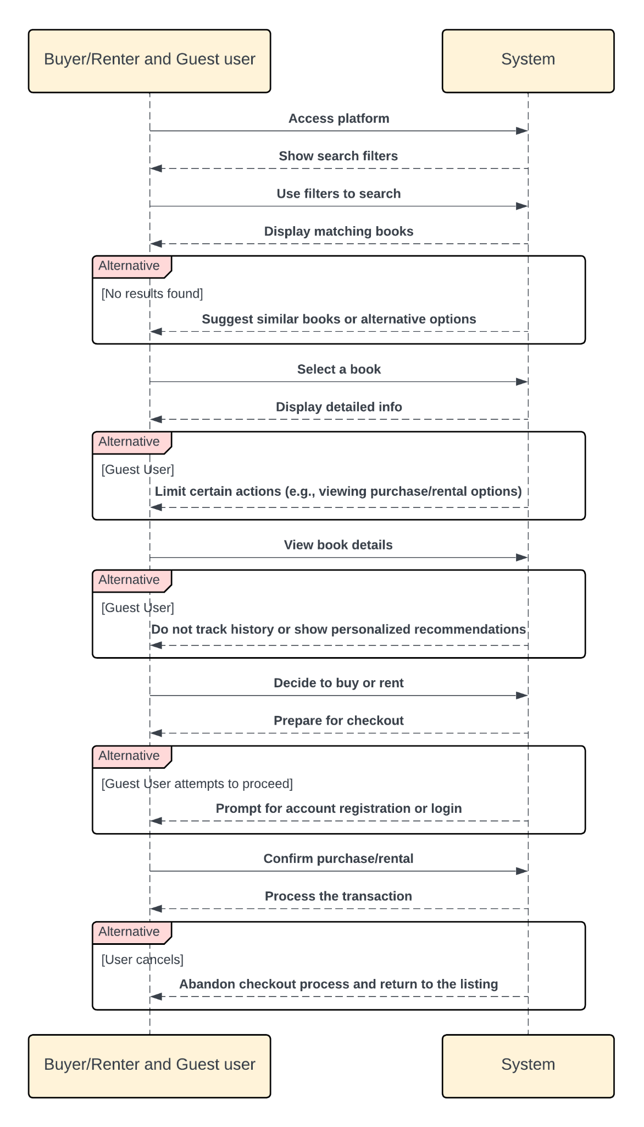
3) Search for book
A buyer, renter, or guest user searches for books, views details, and selects a book.

Slide 23
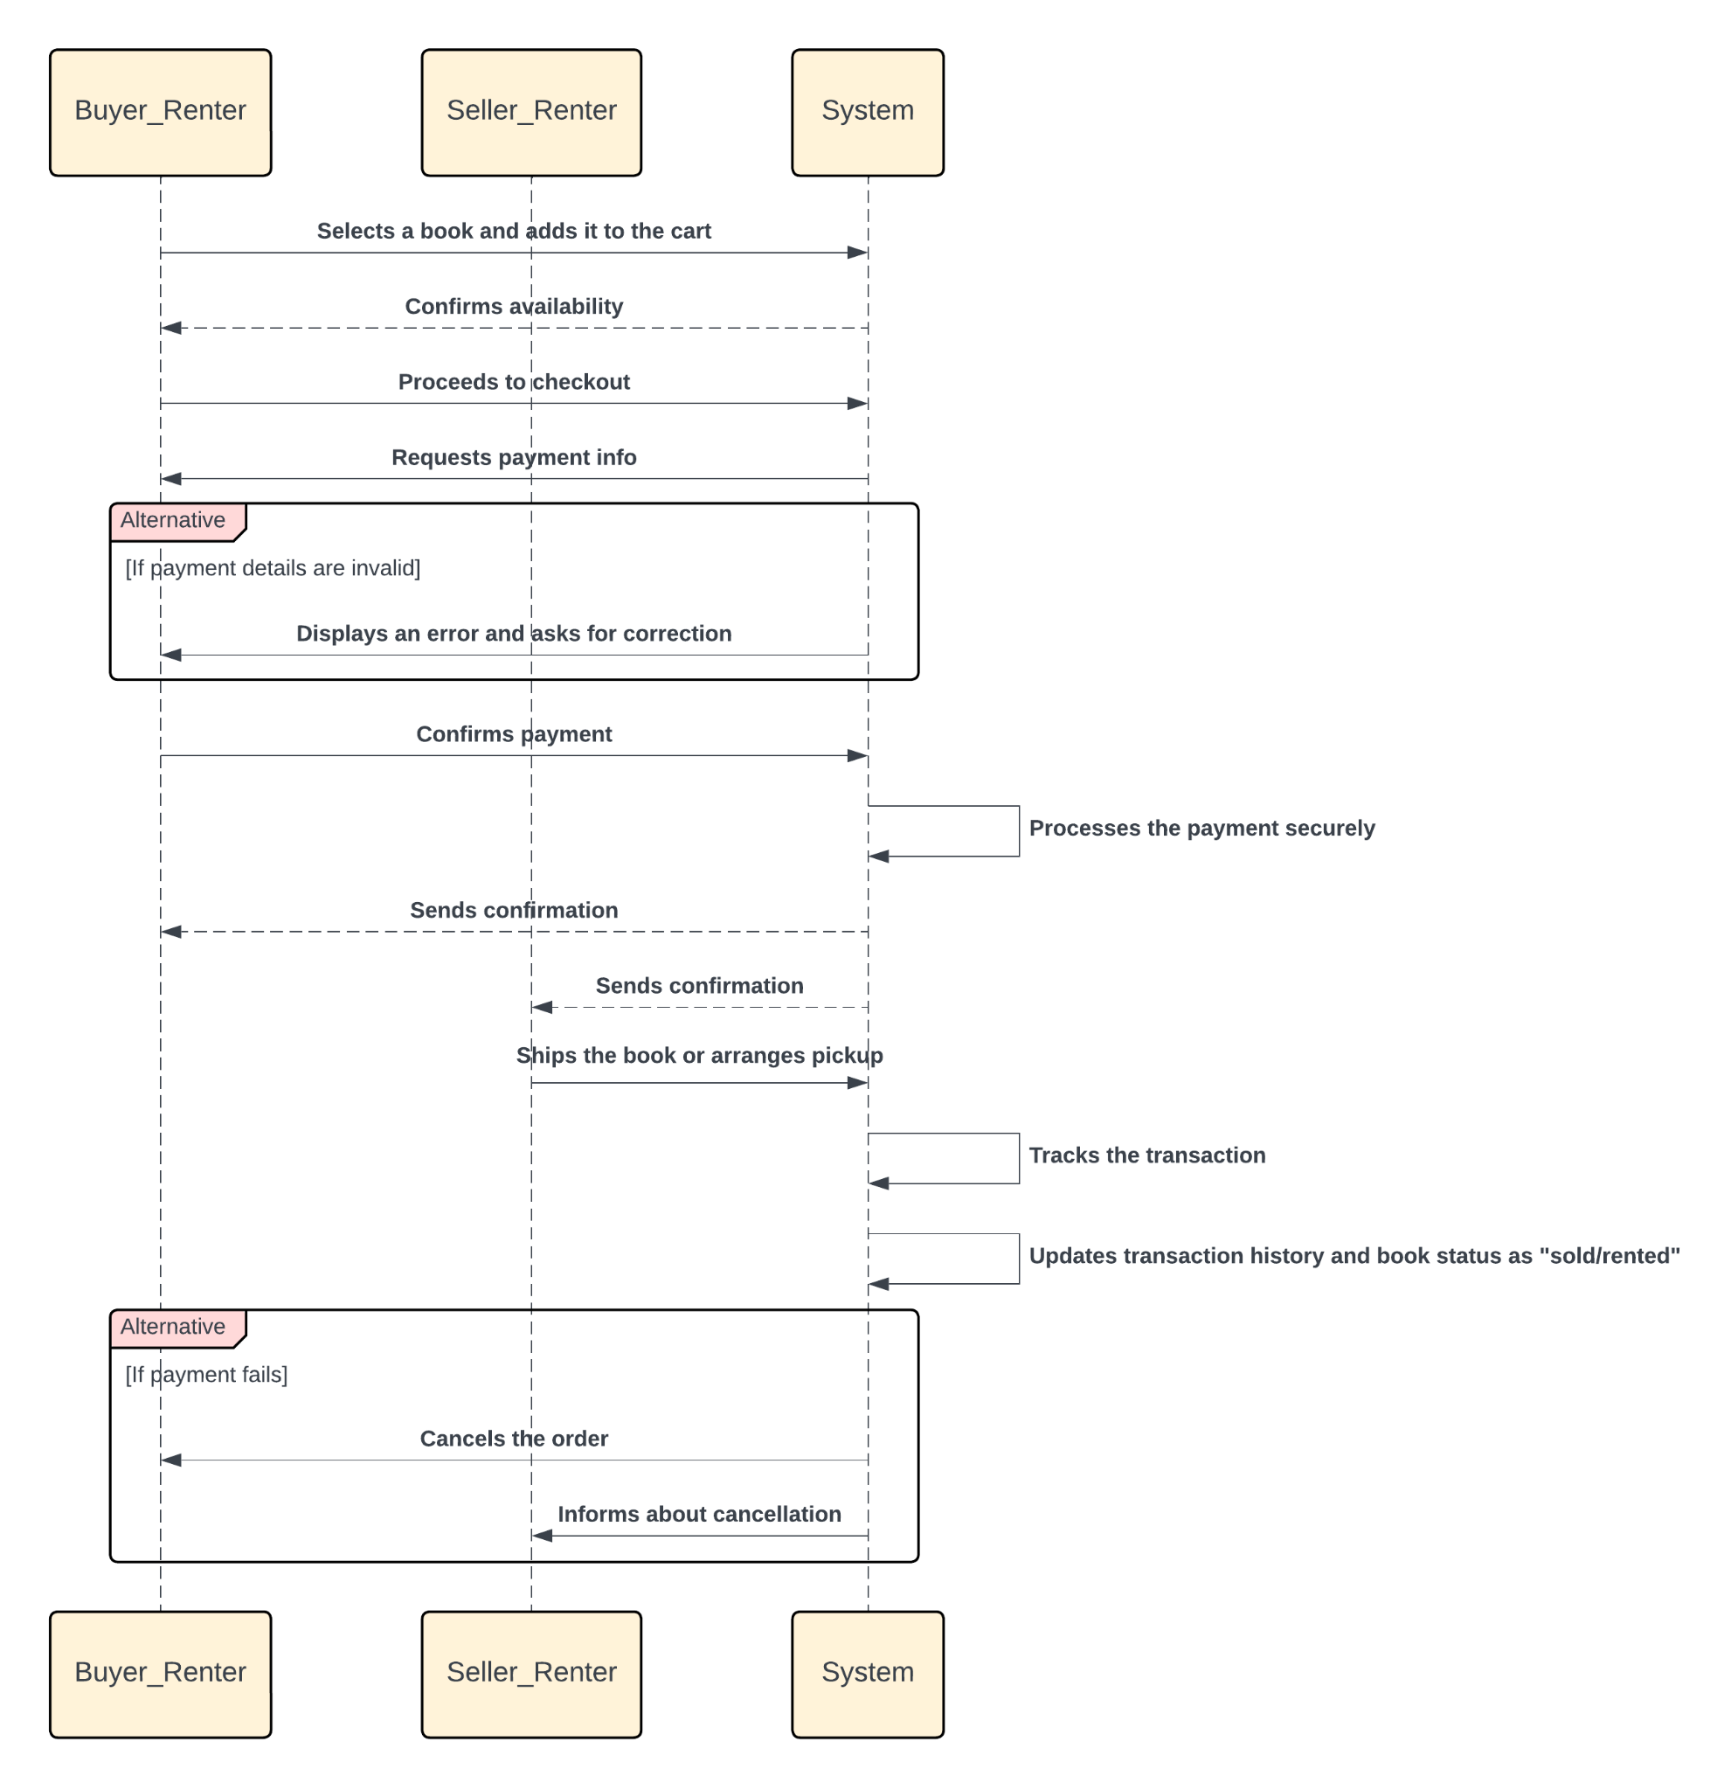
4) Pay for book
The buyer or renter adds books to the cart, checks out, and the system processes payment and updates both parties.

Slide 24
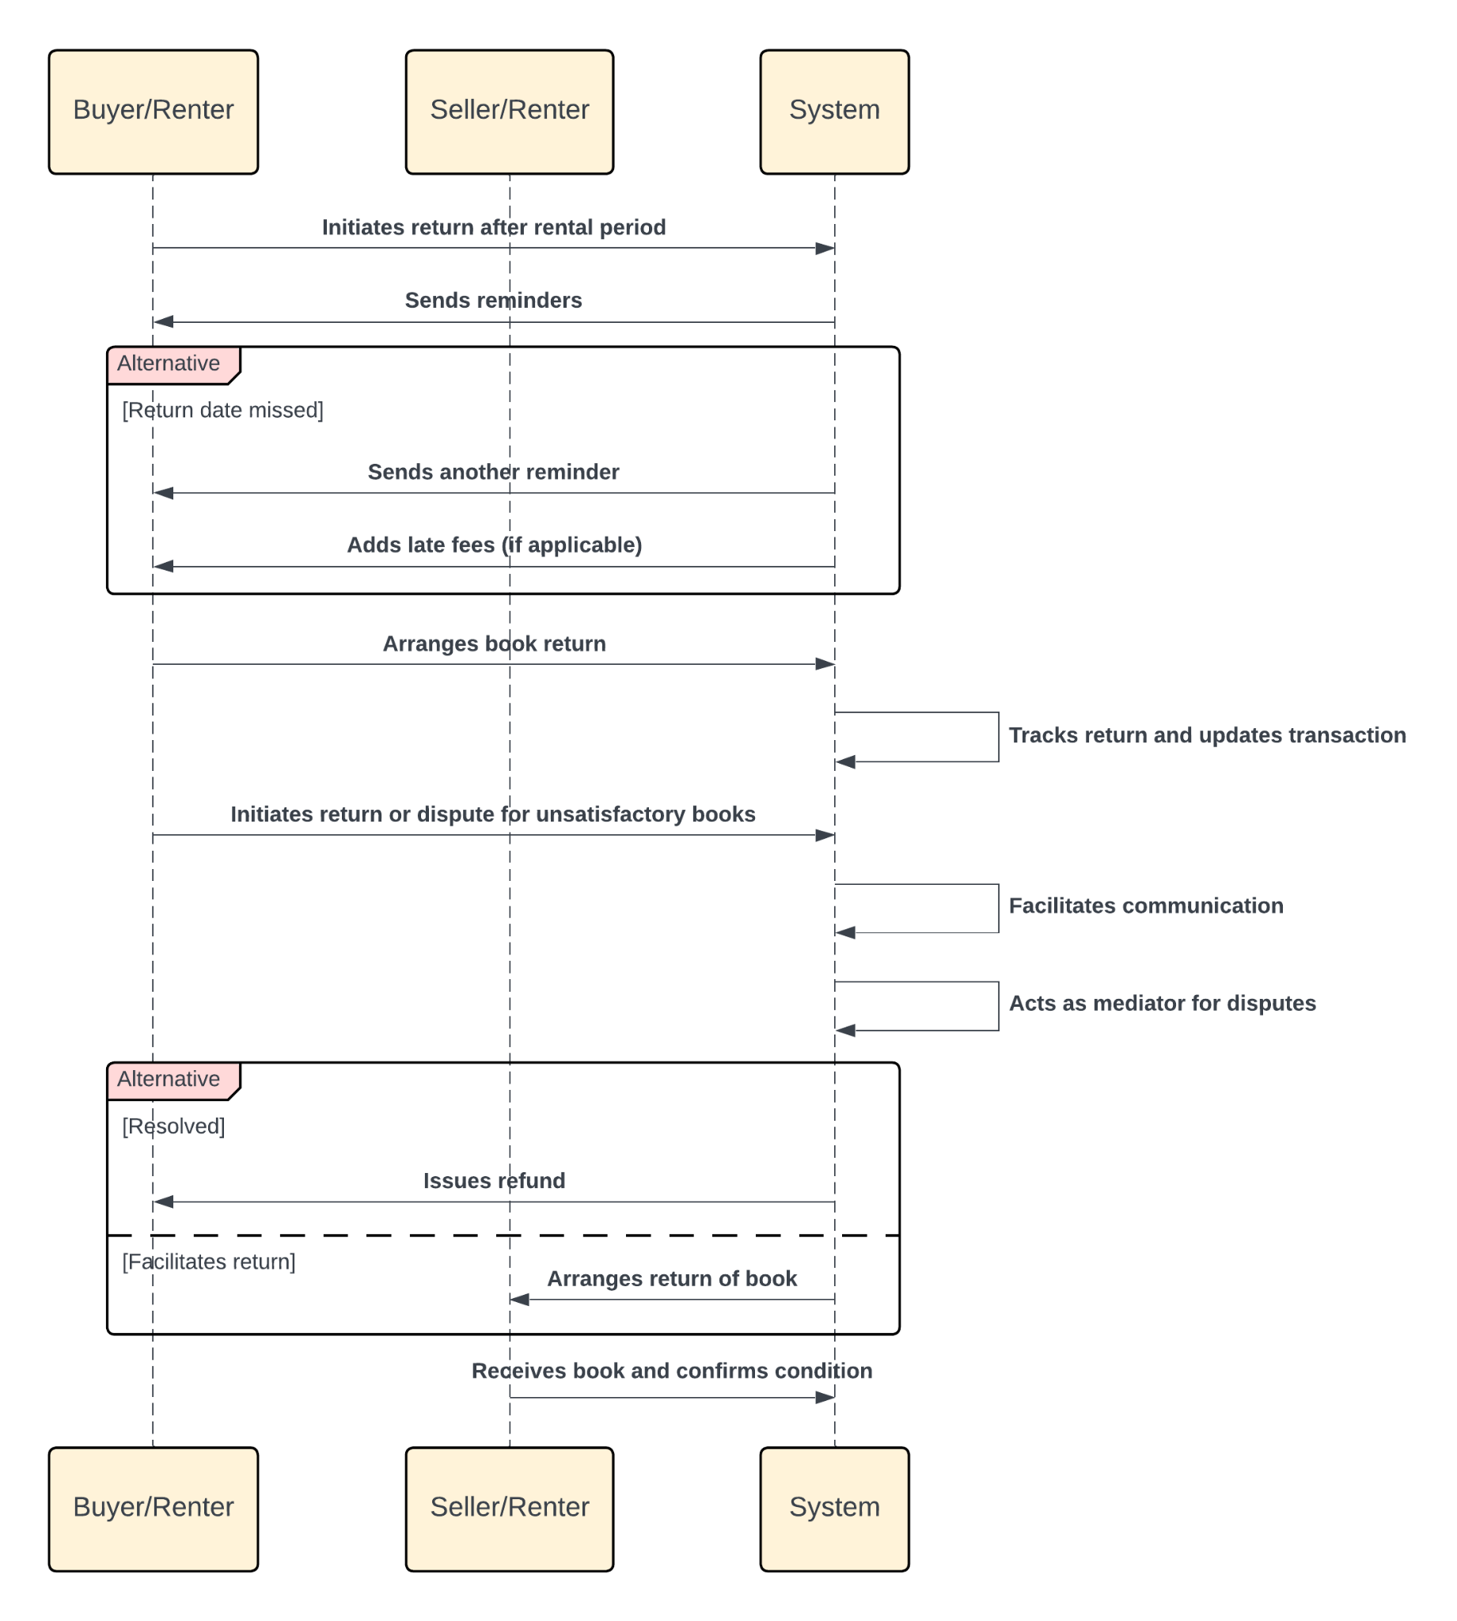
5) Return book
The buyer or renter initiates a return or dispute, and the system tracks returns while the seller resolves the issue.

Slide 25
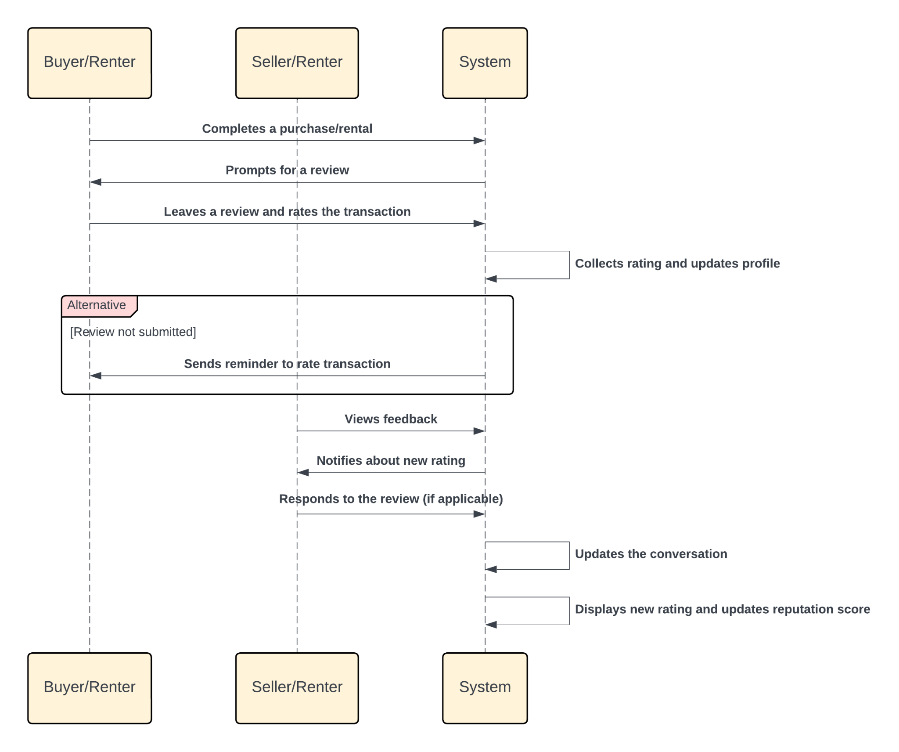
6) Send reviews
The buyer or renter leaves a review, the system updates the profile, and the seller views the feedback.

Slide 26
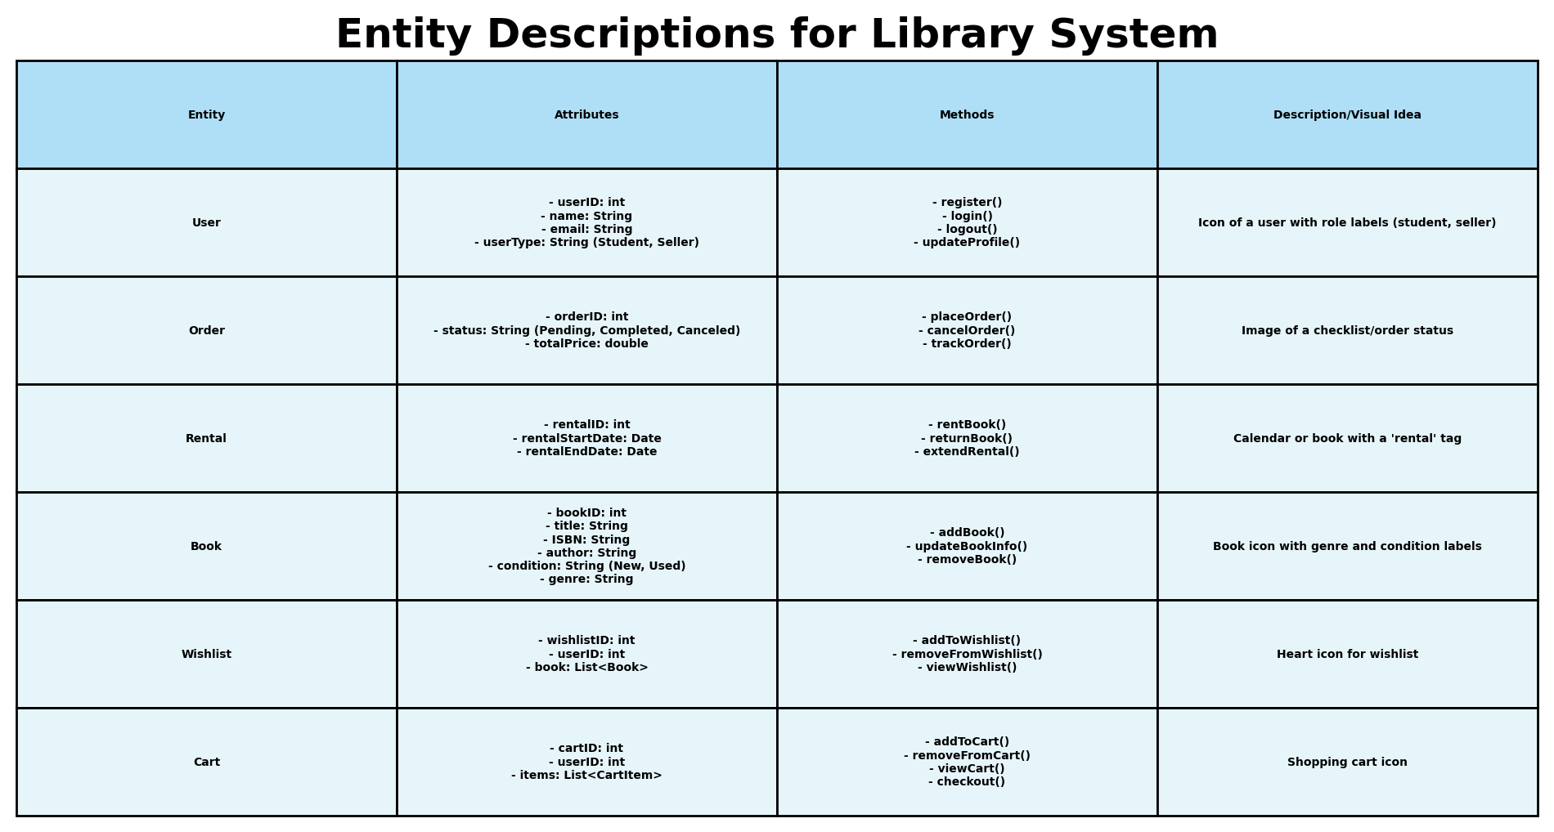
Class diagram Entities
Overview of Key entities
Attributes and Methods
User Roles and Actions
Icons for functionality

Slide 27
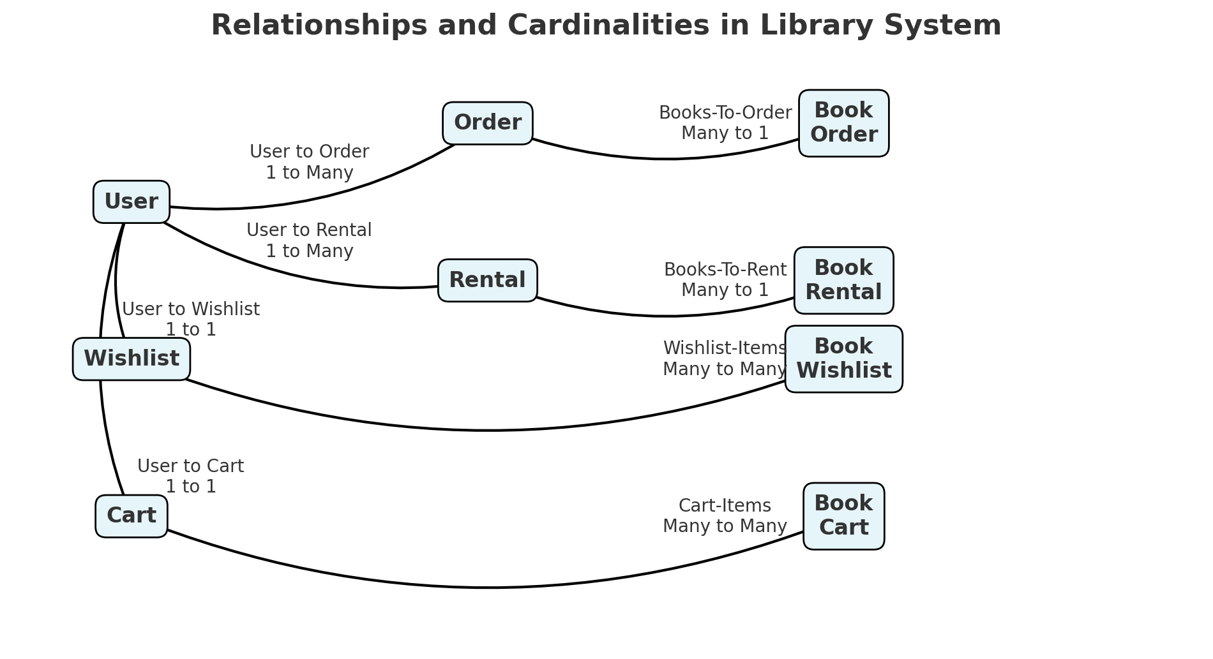
Class diagram Relationships (Omar)
Key relationships and associations
User constraints and design for data integrity and QoL
Specific functions of entities and scalability

Slide 28
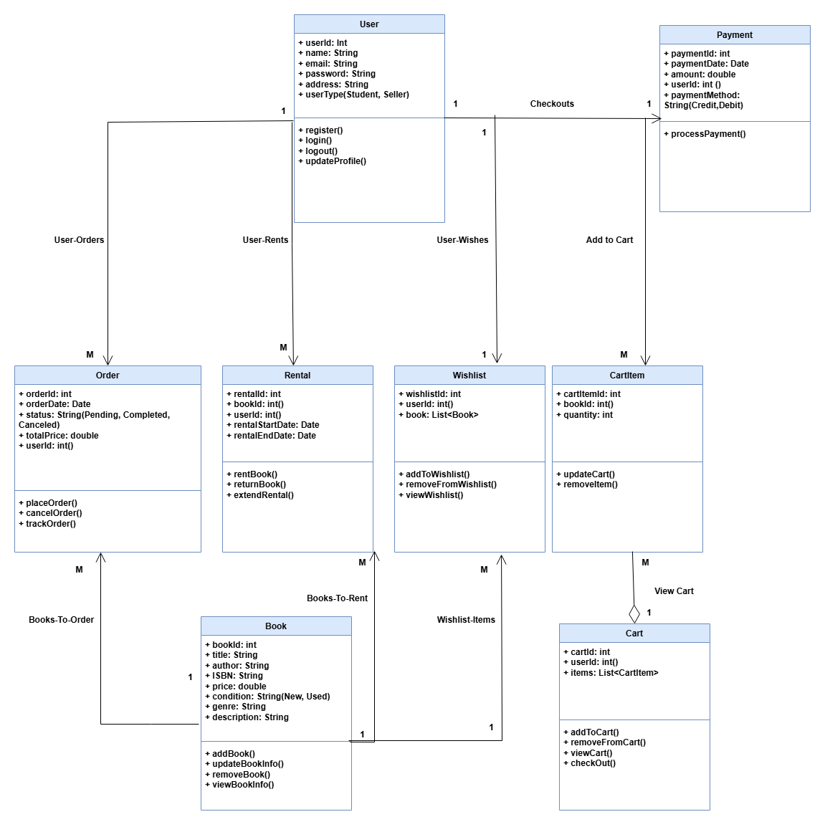
Class diagram Overview
Streamlined payment operations
Efficient methods to order, track and wish-list numerous books
Thousands of books to choose from with no user-data issue!

Slide 29
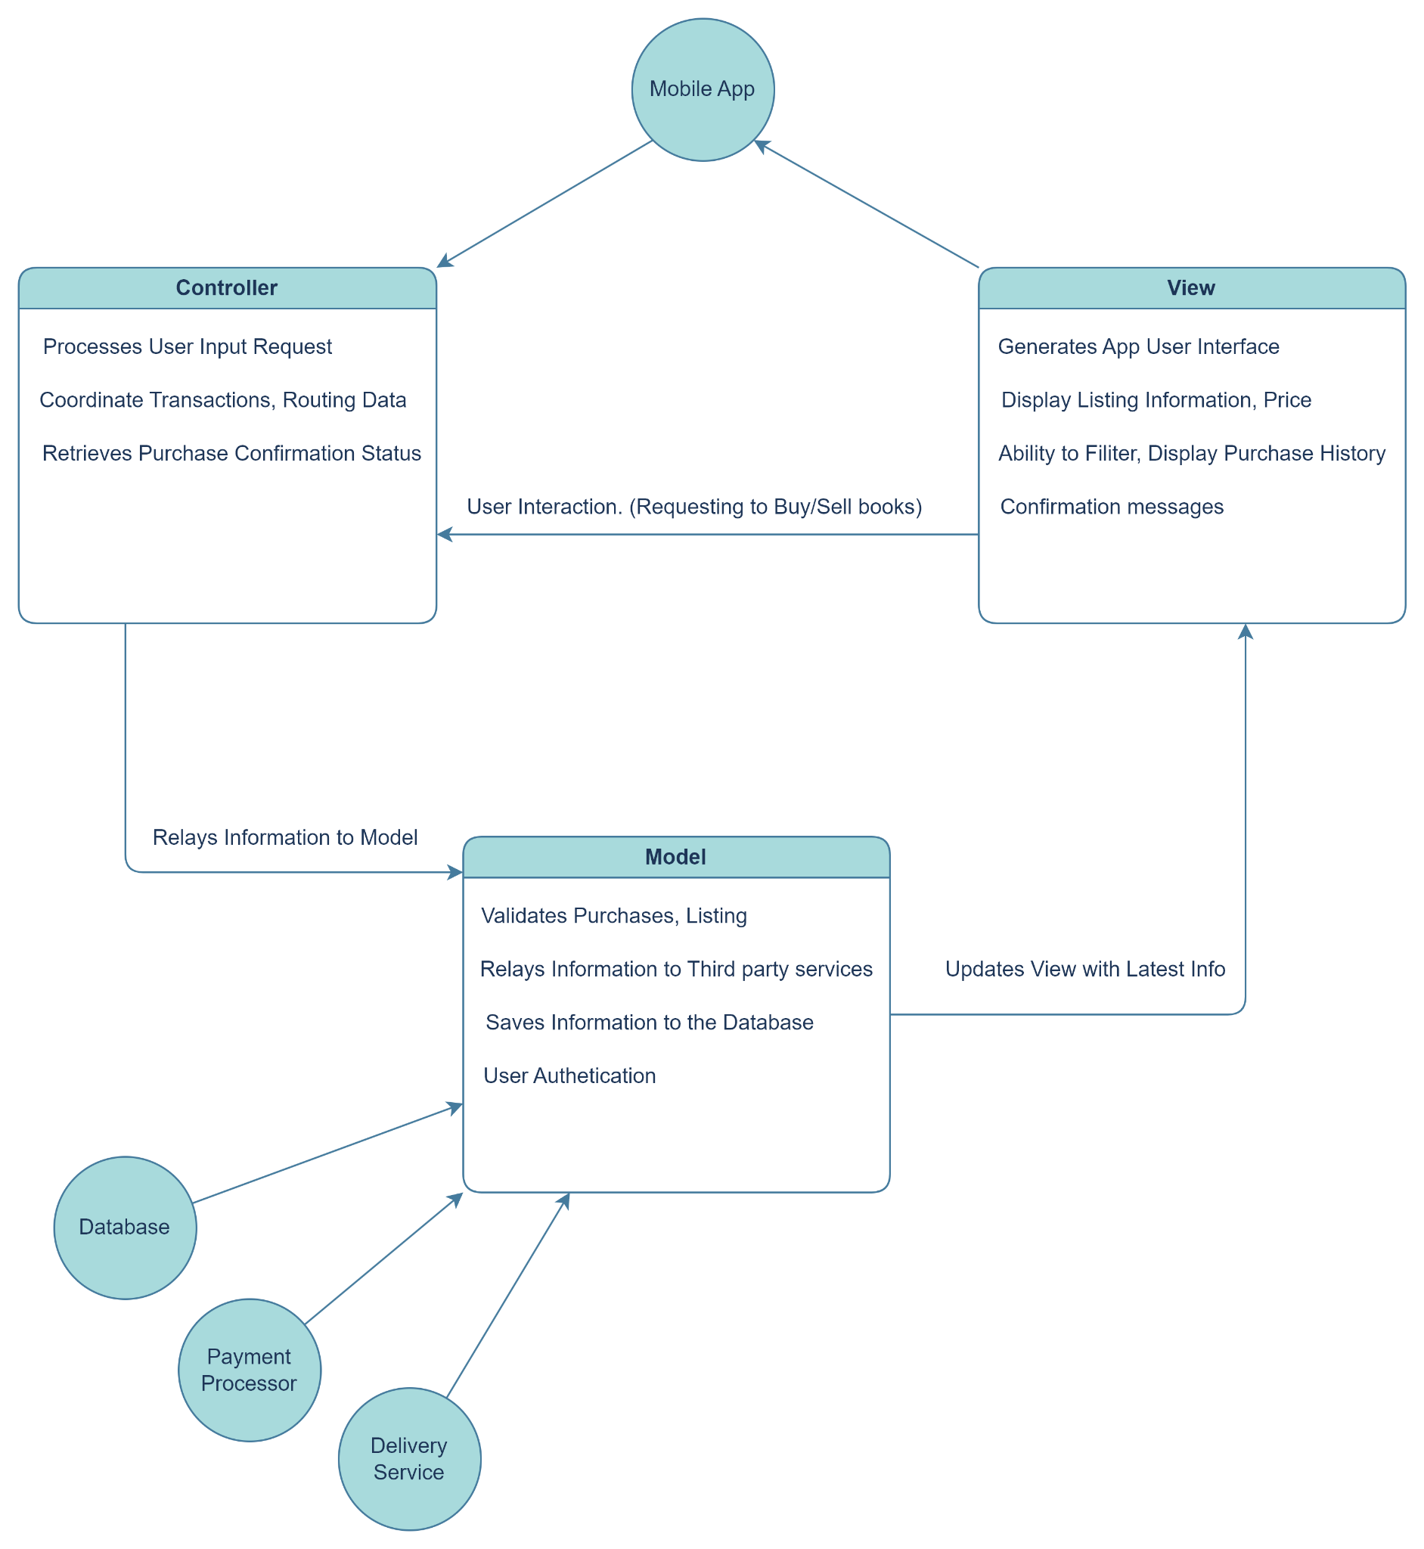
Architectural design
Model View Controller Architecture
Seperate view components for Sellers/Buyers while sharing common code
Seasonal demand is an issue and MVC lets us scale up/down as needed

Slide 30
Demo of user interface
Link to Figma Prototype

